Slide 1


DTSA 5509 Final Project
Predicting MMA Fighter Performance

Slide 2
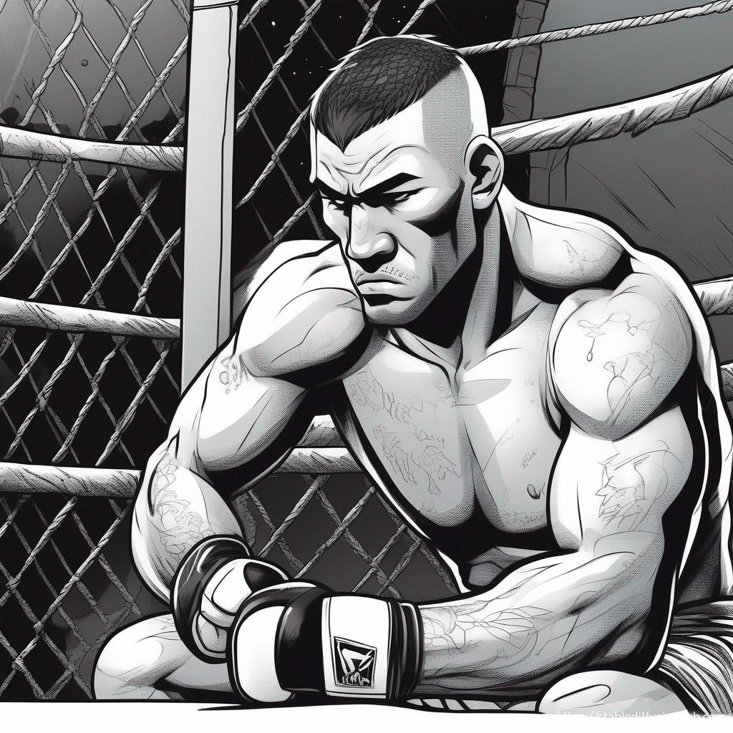
The Problem
Fighting as a profession requires wins and longevity
Many training styles
Many potential weight classes
How can a fighter maximize professional opportunity?

Slide 3
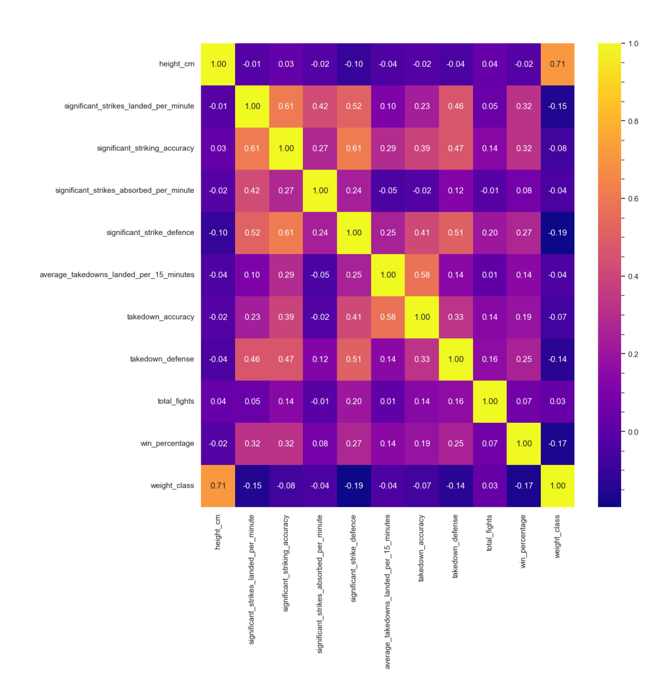
Data
Data cleaned to remove any outliers or clear errors
Some important data missing such as reach and submission data
No obvious collinearities within the data based off the heat map
Data URL: https://www.kaggle.com/datasets/asaniczka/ufc-fighters-statistics/data

Slide 4

Model Creation
Used physical traits and fighting proficiencies to predict fighter longevity and success rate.
Models were multi linear regressions made using Ordinary Least Squares Method
Both models had a k value of 6 but the features differed

Slide 5
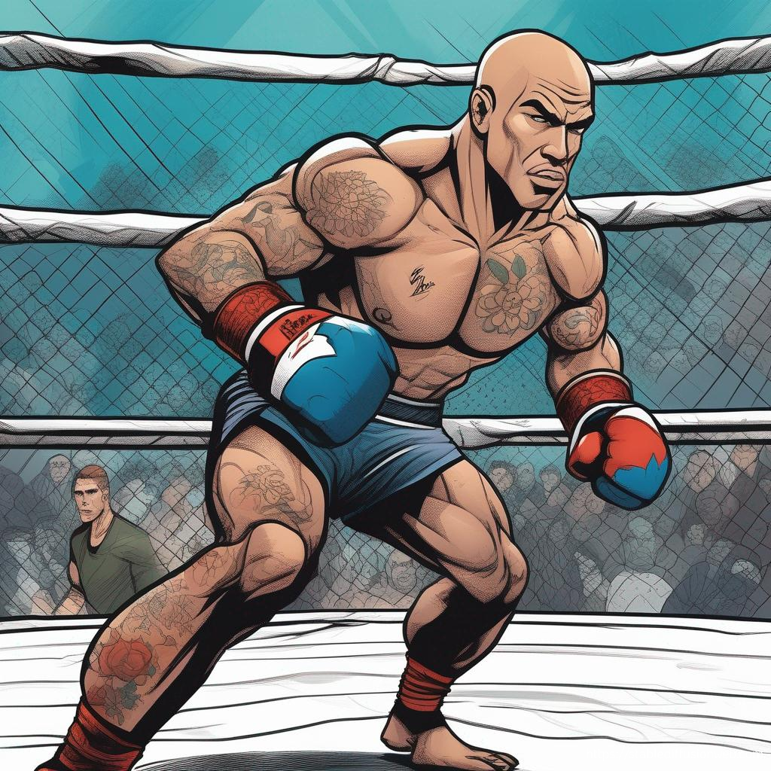
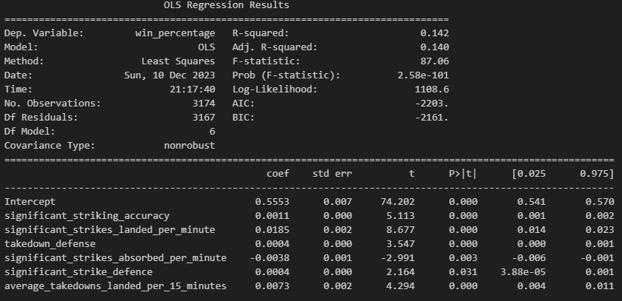
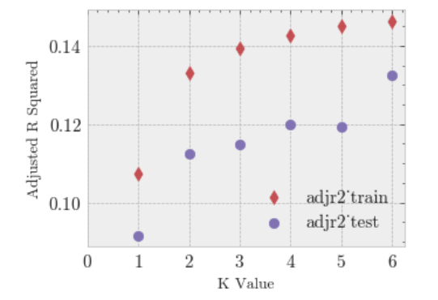
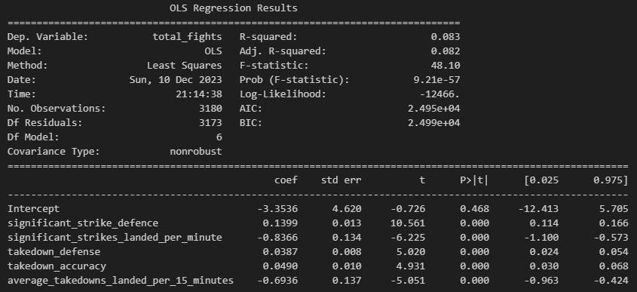
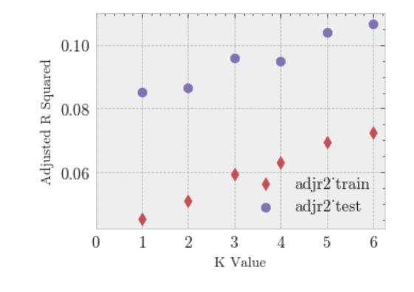
Results

